Slide 1



Final Group Project
Group No: 4
ASP
BDAT 1004
Data Programming
Prof. Thomas Parker

Slide 2




















American NBA Teams

Slide 3
Project Summary
The National Basketball Association (NBA) is a professional basketball league in North America. The league is composed of 30 teams (29 in the United States and 1 in Canada) and is one of the major professional sports leagues in the United States and Canada.
The league is divided up into two conferences, the Eastern Conference and the Western Conference. The Eastern conference has three divisions called Atlantic, Central, and Southeast. The Western Conference also has three divisions, which are the Northwest, Pacific, and Southwest. Each division has 5 teams.

Slide 4
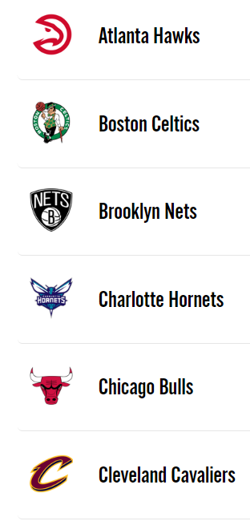
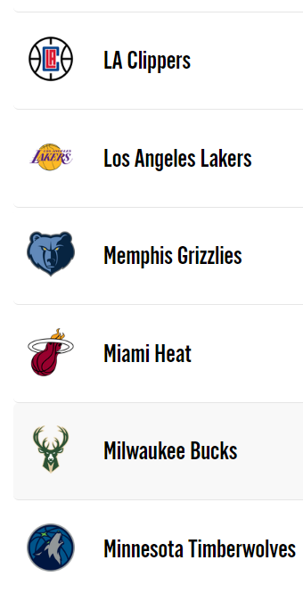
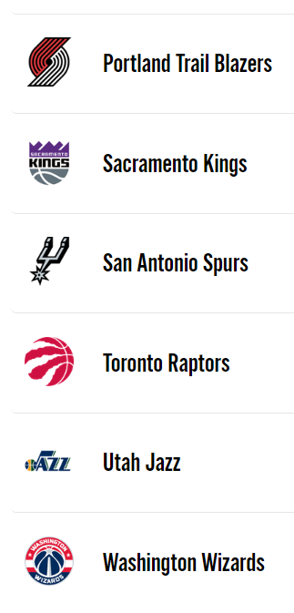
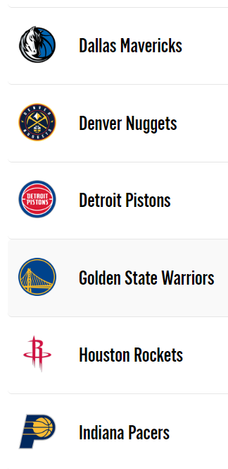
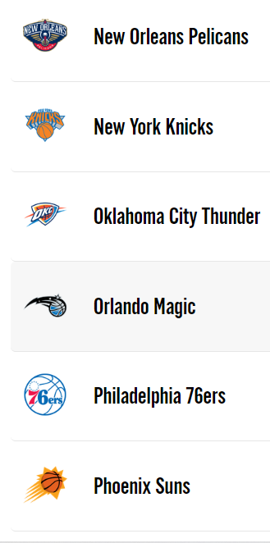

Slide 5


Group Members
Abdul-Baatinul-Haad Yusuf
Athul Varghese
Team Role:
Developer
Education:
bachelor of software engineering
Skills :
Programming, Documentation, Analytical
Languages:
Python, Java, C#
Team Role:
Data Analyst
Education:
Bachelor Of Computer Application
Skills :
Logical and Analytical skills
Languages:
C#, Python

Slide 6


Group Members
Libina Puthenpurayil Joseph
Aiswarya Prakash
Team Role:
Project Manager
Education:
BSc Physics,
Master in Computer Applications
Skills :
Problem-solving
Analysis skills
Languages:
C#, Python
Team Role:
Business Analyst
Education:
BTech,
Masters in Business Administration
Skills :
Team Management
Problem-solving
Languages:
C#, Python

Slide 7
Dataset
Our dataset works on 6 variables
Abbreviation : 3 letter word, an acronym for the Full name
City : place where team is located
Conference : Two types (East, West)
Division : 6 divisions (Southeast, Atlantic, Central, Southwest, Pacific, Northwest)
Full Name : Team name
Name : Popular name

Slide 8
The Project
1. The project works on a Visual Studio Code platform.
2. We made use of the “pandas” Library. To make use of data analytical tools.
Pandas Library: Pandas is a software library written for the Python programming language for data manipulation and analysis. In particular, it offers data structures and operations for manipulating numerical tables and time series.

Slide 9
The Project
import pandas as pd
from pymongo import MongoClient
import json
import numpy as np

Slide 10
3. Connection to the MongoDB database.
4. Use of Flask
Flask: Flask is a small and lightweight Python web framework that provides useful tools and features that make creating web applications in Python easier. It gives developers flexibility and is a more accessible framework for new developers since you can build a web application quickly using only a single Python file.
from flask import Flask, jsonify, request, render_template
from data import division_count

Slide 11
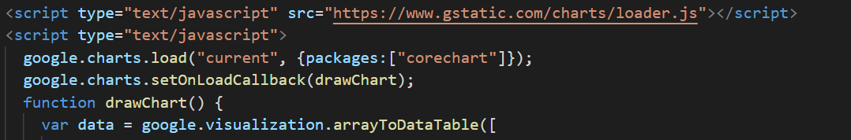
5. Google Chart Visualizations

Slide 12
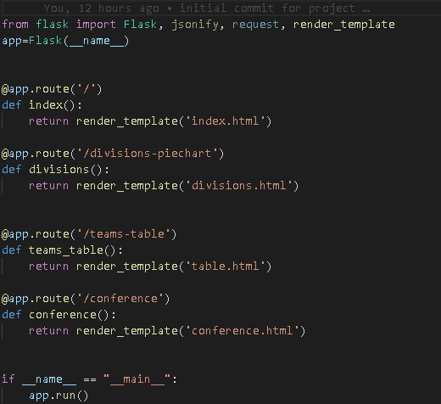
6. Routing to various pages

Slide 13
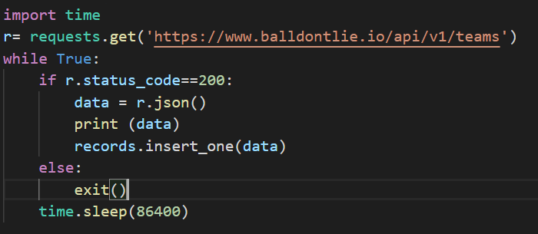
7. Use Python to run a pseudo-batch process that runs every 24-hours
8. The web application can be accessed by this URL
https://data-prog-finalproject.herokuapp.com/

Slide 14
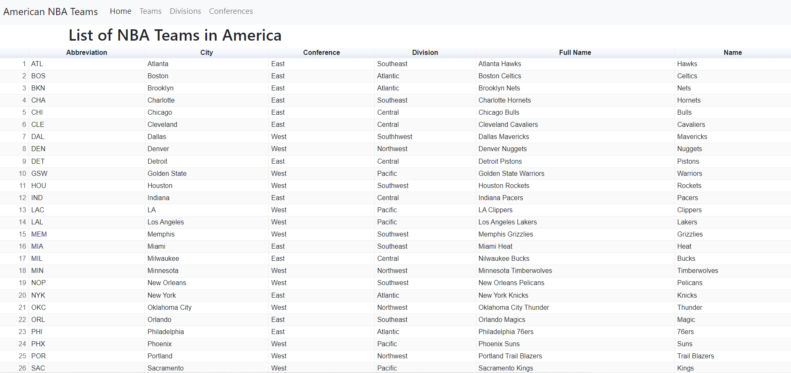
1. List of NBA Teams in America

Slide 15
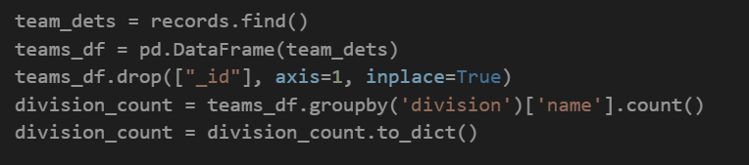
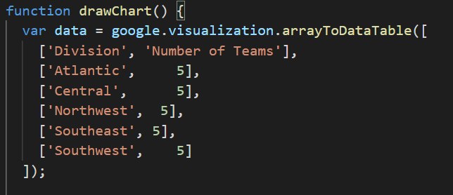
2. Percentage of Team divisions

Slide 16
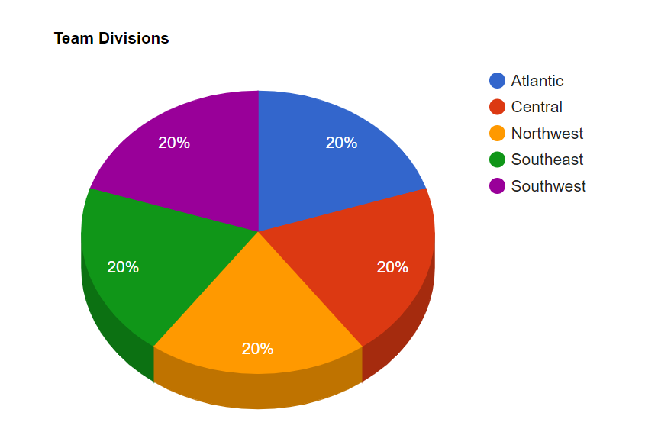
Percentage of Team divisions

Slide 17
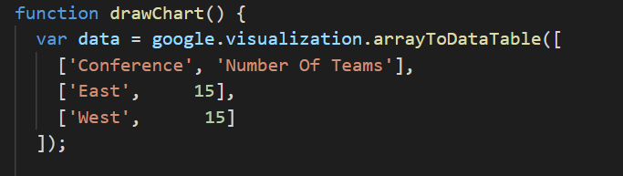
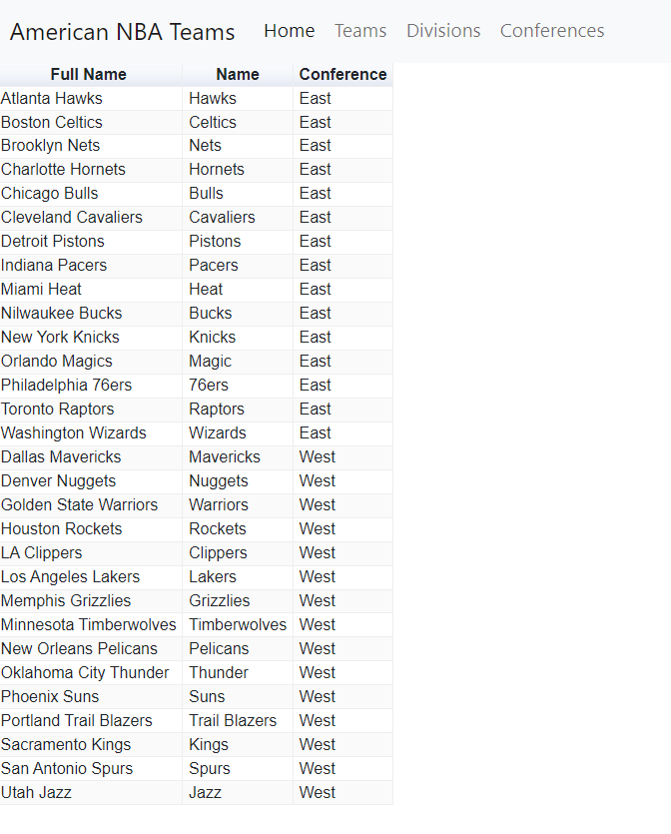
3. Percentage of Teams in Each Conference

Slide 18
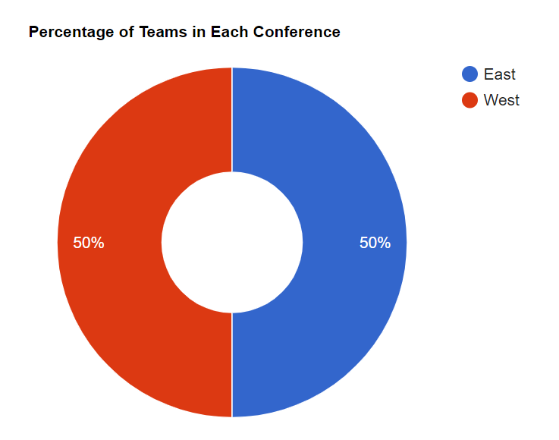
Percentage of Teams in Each Conference

Slide 19
Demonstration

Slide 20


